Slide 1
ART BIBLE
Alex Lopez Agudo

Slide 2
What is Art?

Slide 3
What is Art?
The expression or application of human creative skill and imagination
The making of objects, images, music, etc. that are beautiful or that express feelings

Slide 4
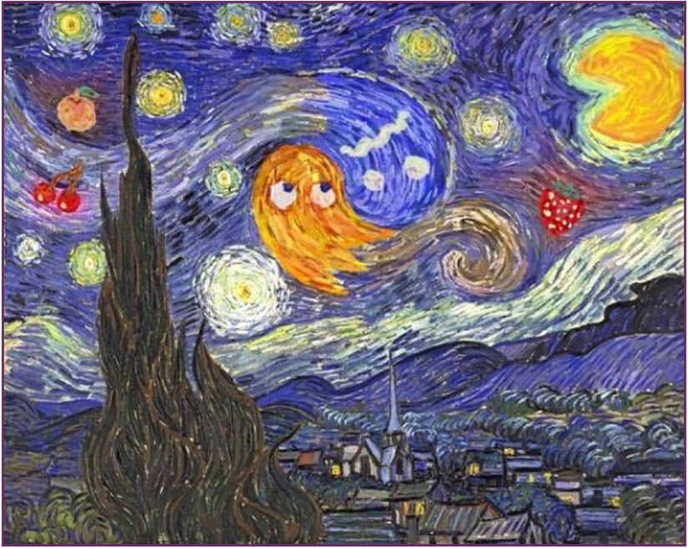
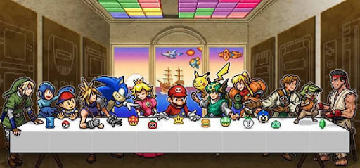
Art in Video Games

Slide 5
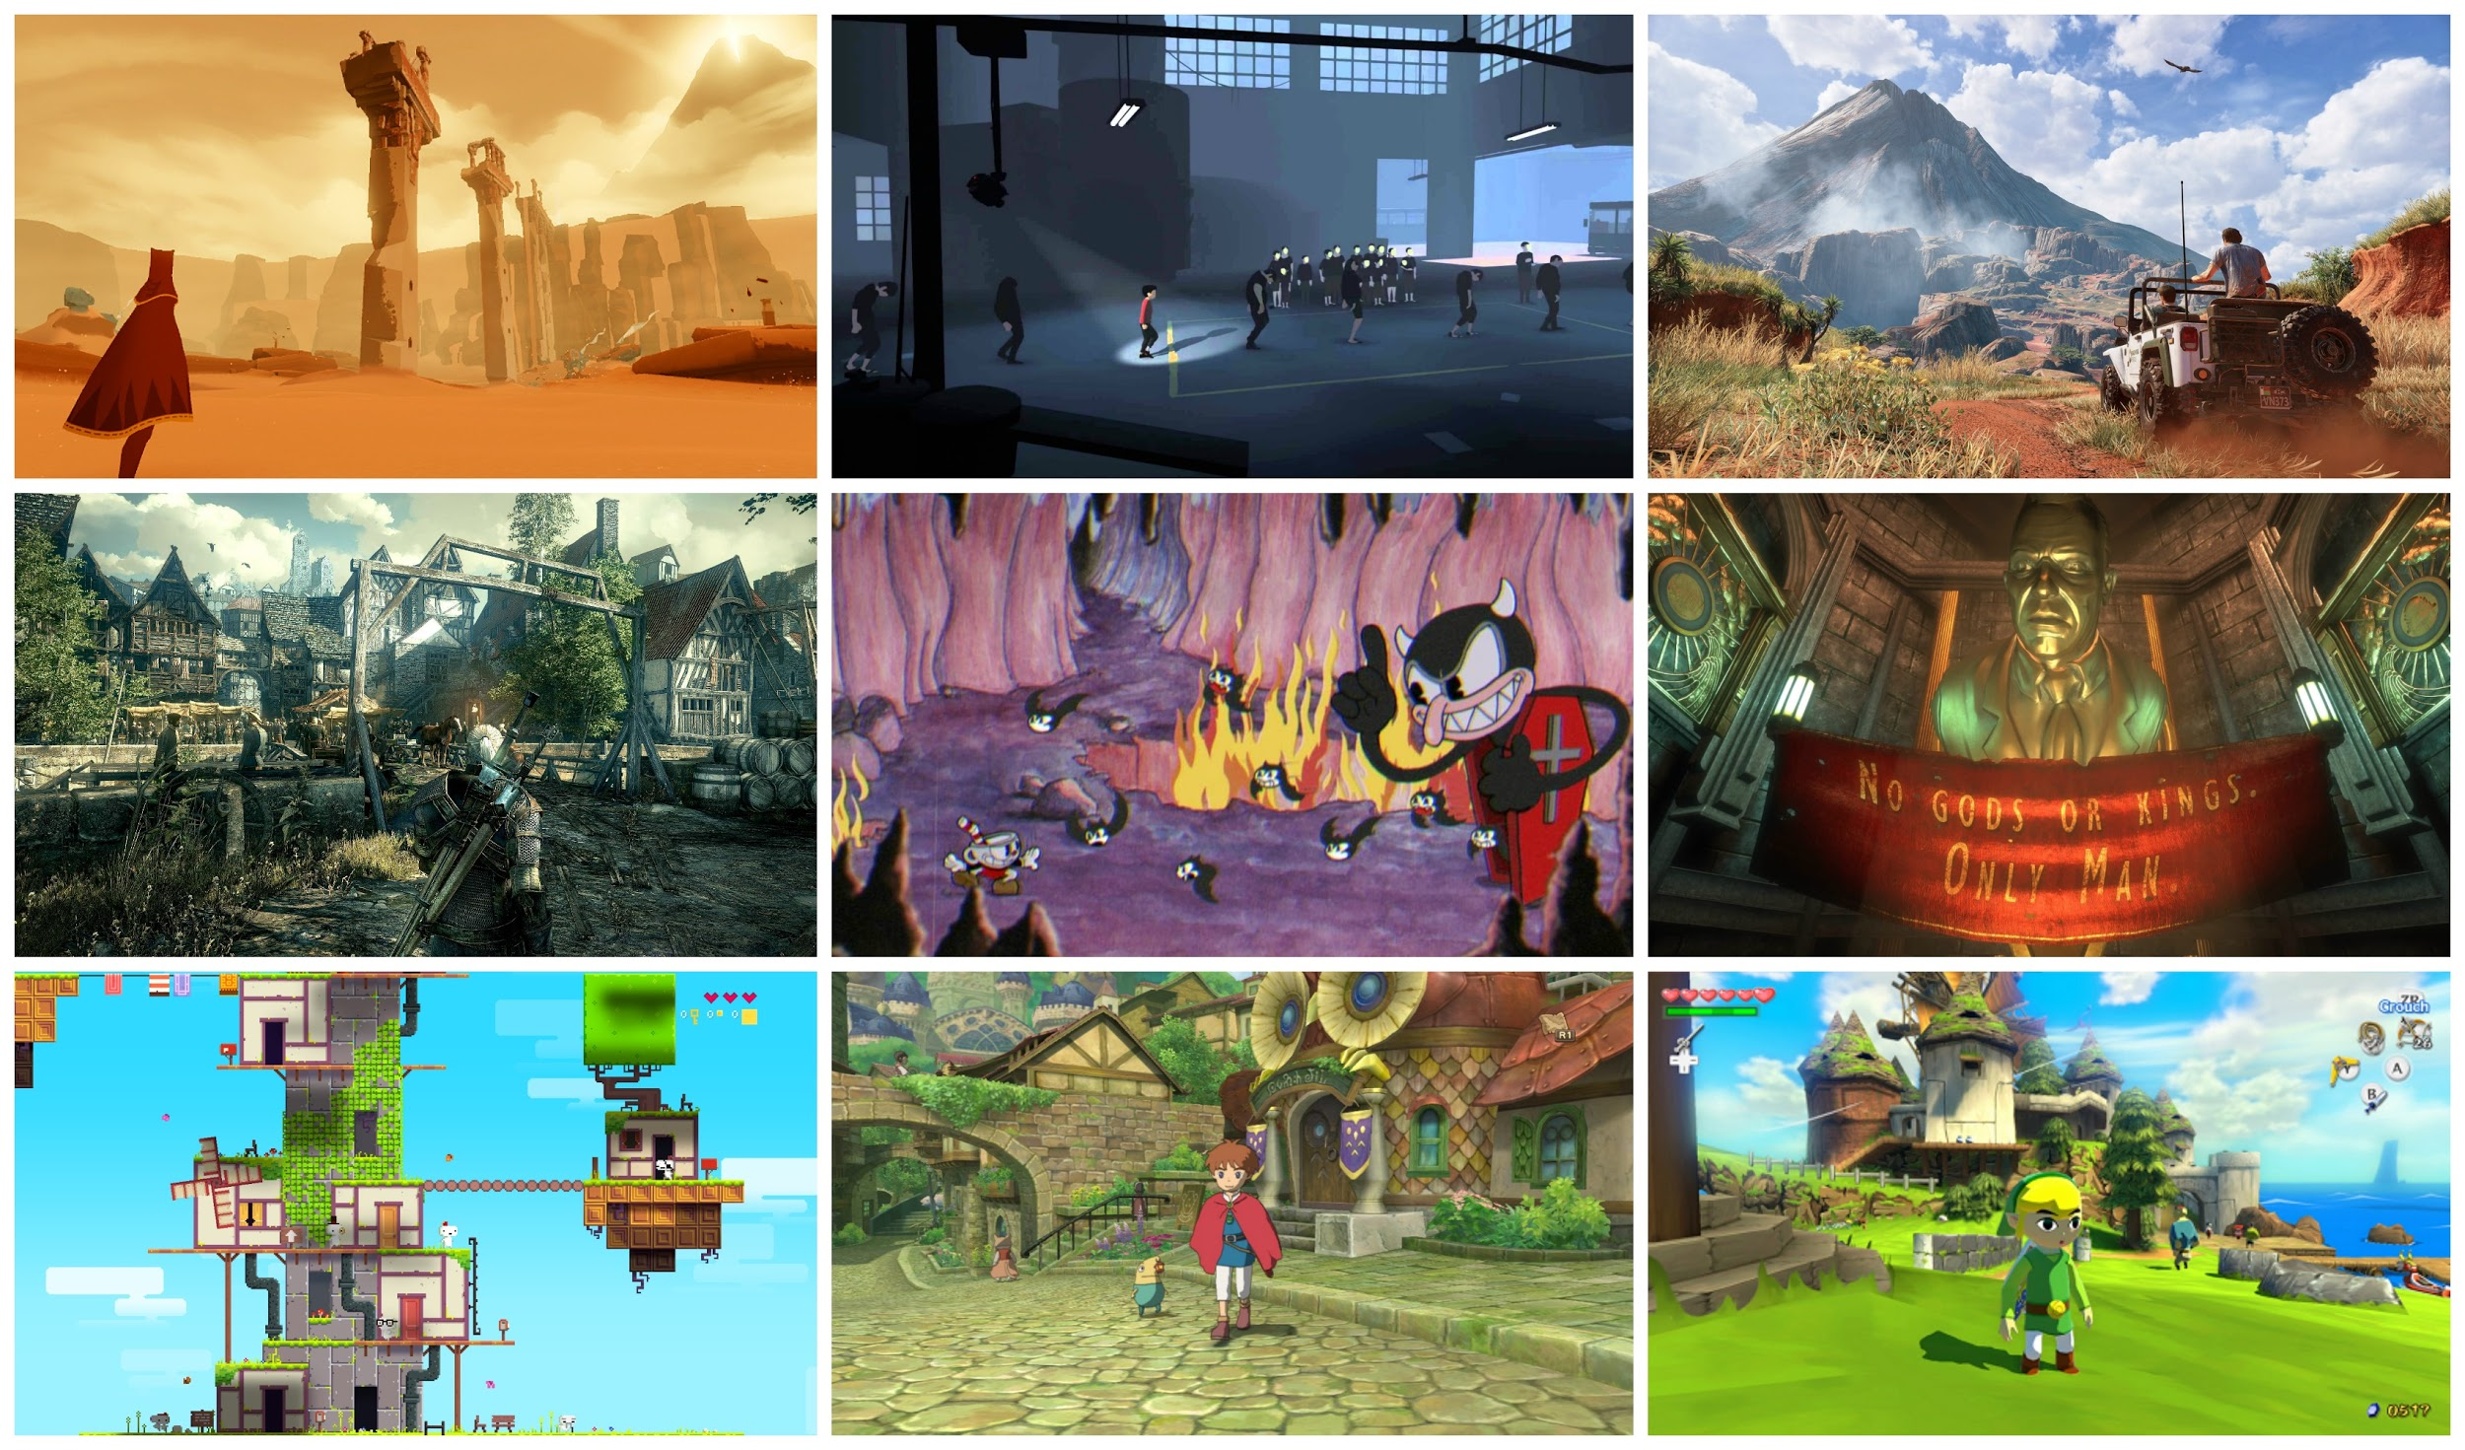

Art Bible
An Art Bible is a document created to communicate to the art team exactly what style the art assets should match.

Slide 6
When do we have to create it and who?

Slide 7
When do we have to create it and who?
Just after the GDD, before the production.
Normally the art director makes it, but in indie studios?

Slide 8
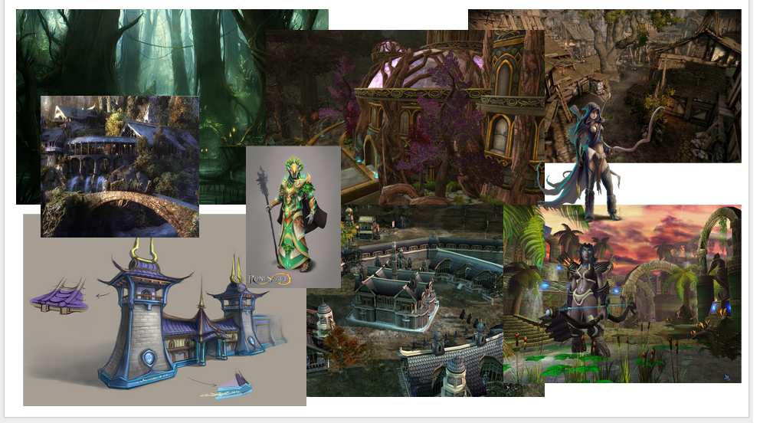
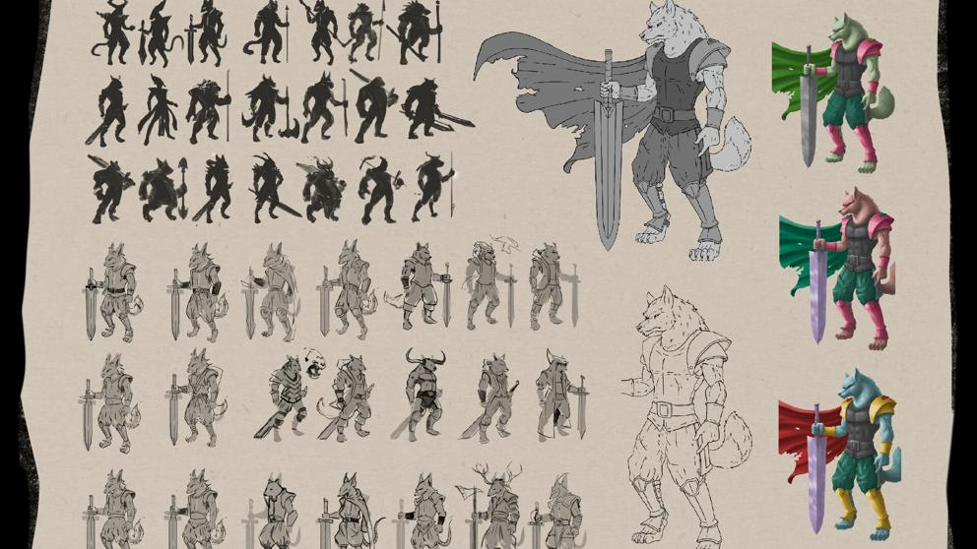
When do we have to create it and who?

Slide 9
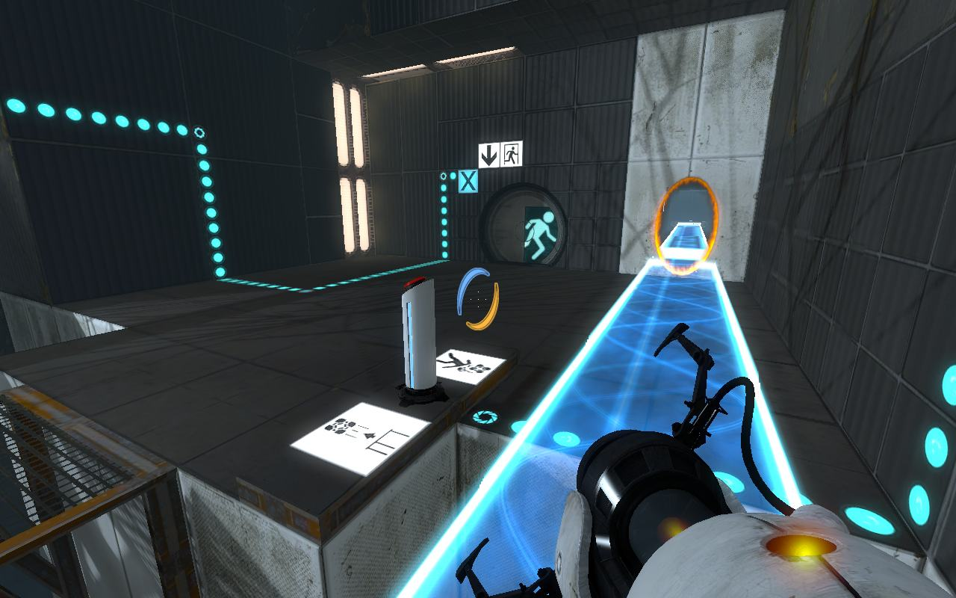
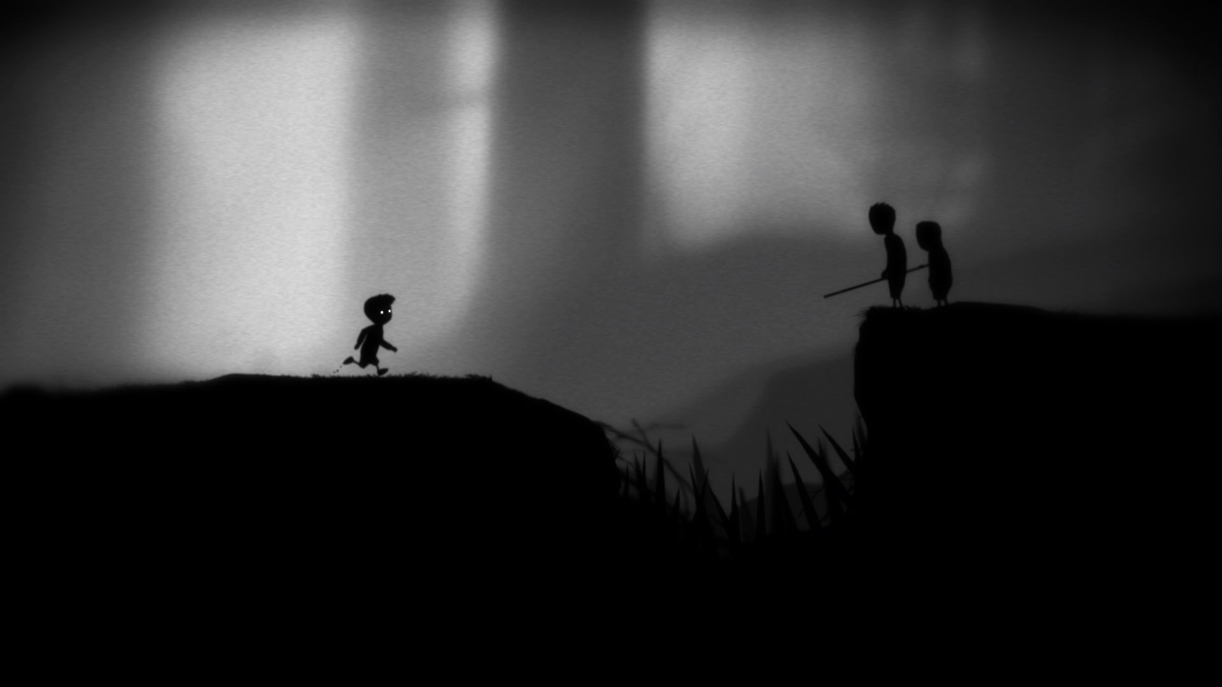
A game should be recognizable just with a photo

Slide 10

A game should be recognizable just with a photo

Slide 11
CONTENTS

Slide 12
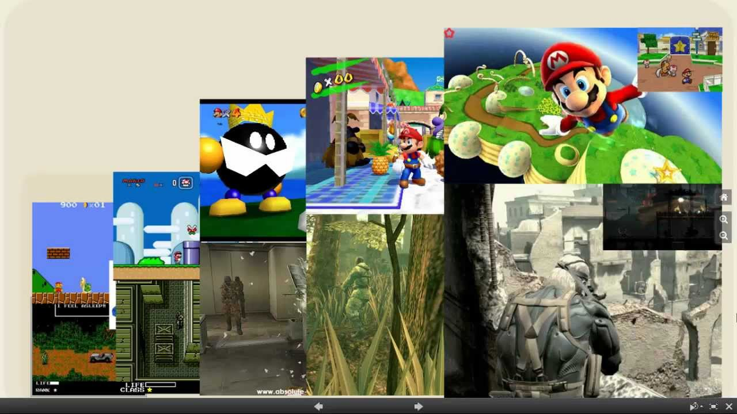
Art Style

Slide 13
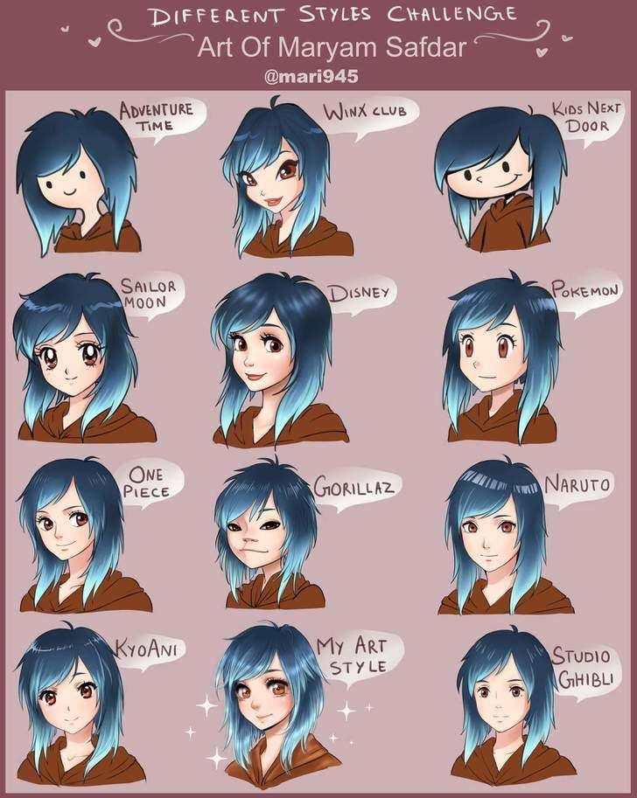

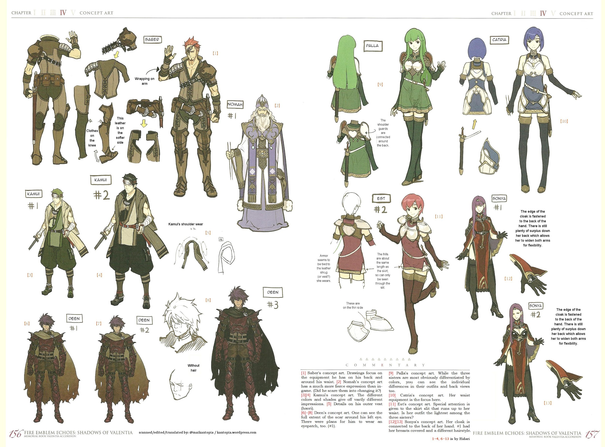
Character Art

Slide 14
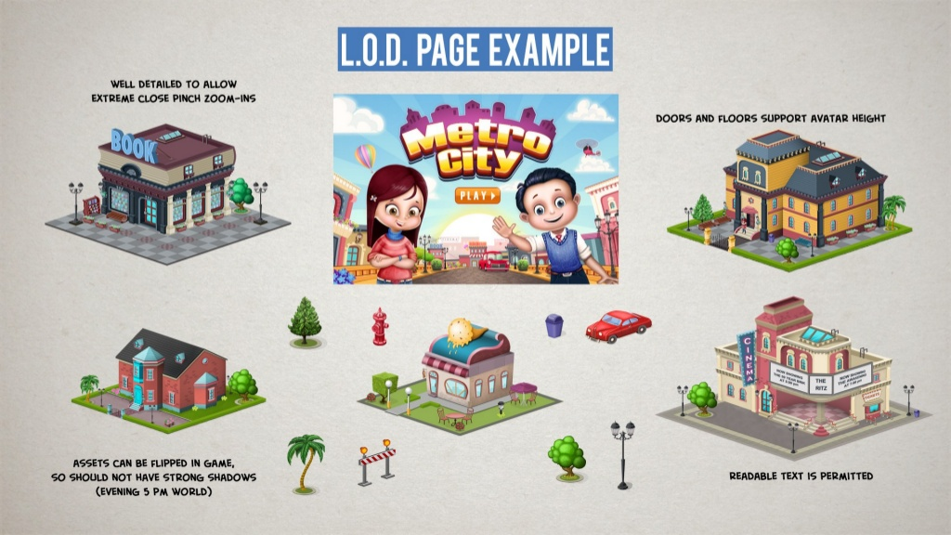
Level of Detail

Slide 15
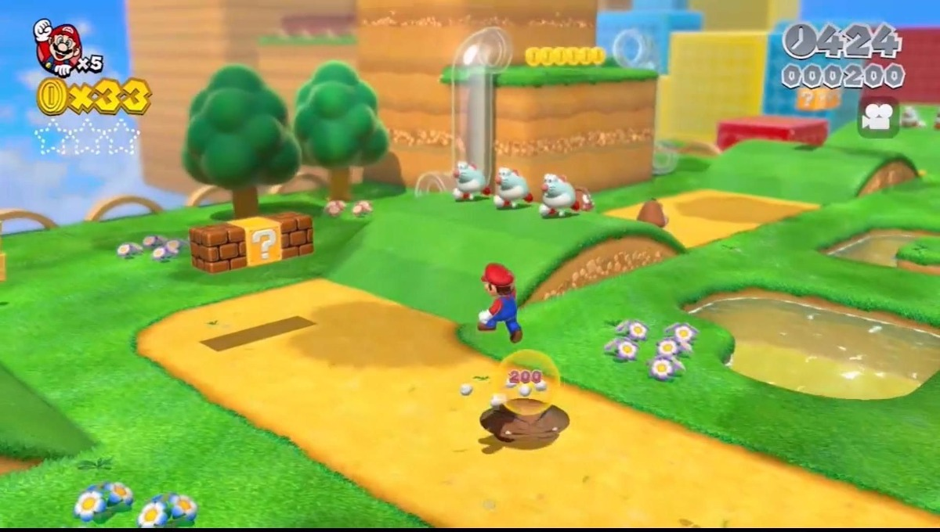
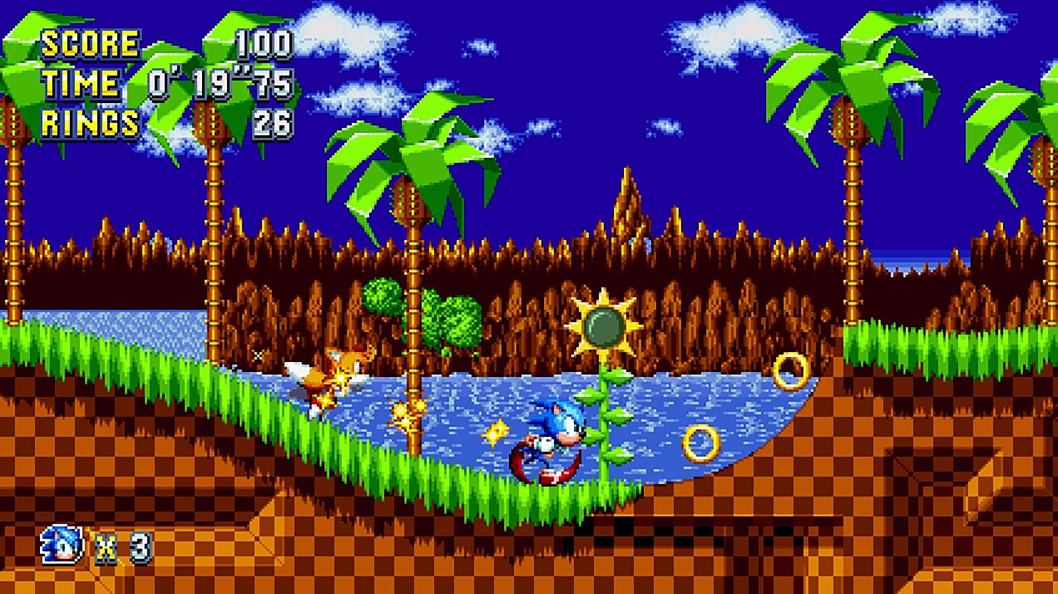
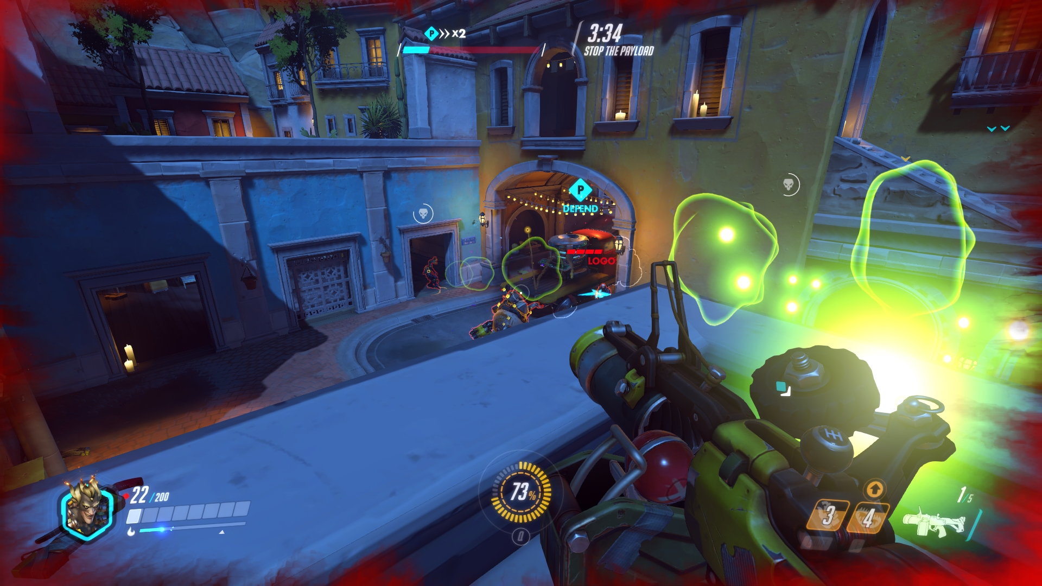
Camera

Slide 16
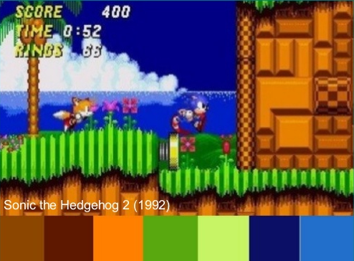
Color Palette

Slide 17
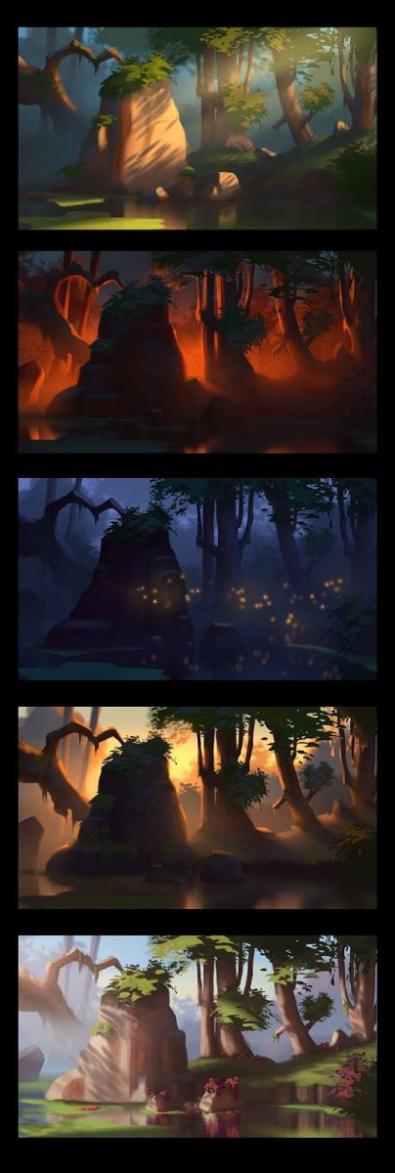
Atmosphere

Slide 18
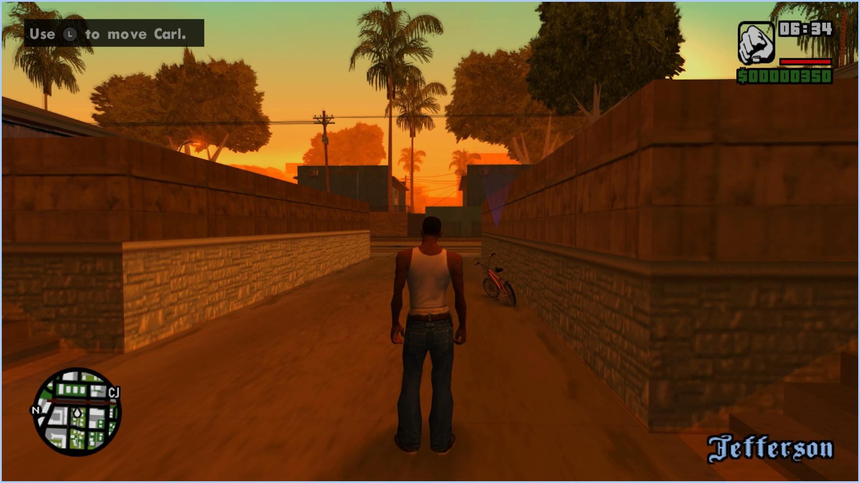
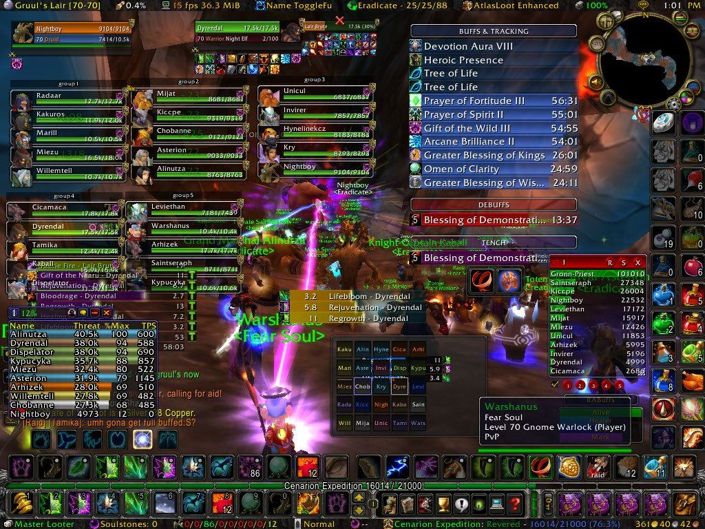
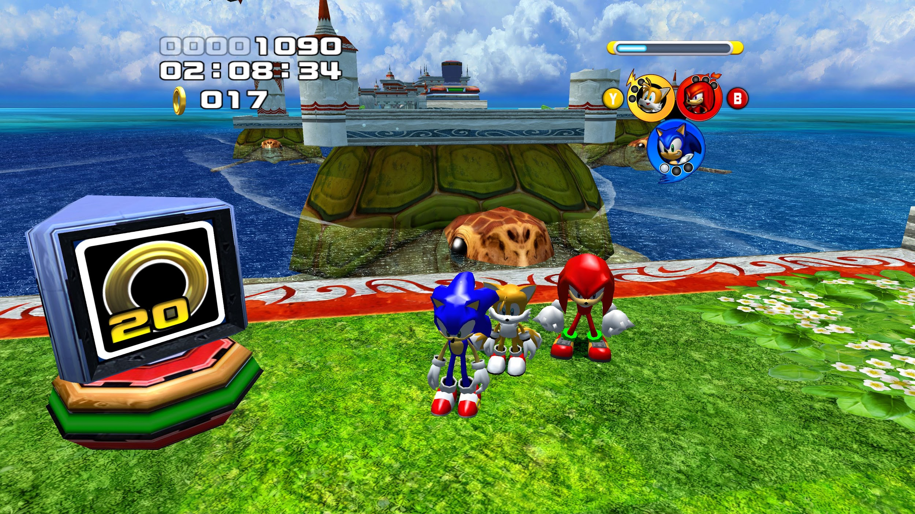
User Interface

Slide 19
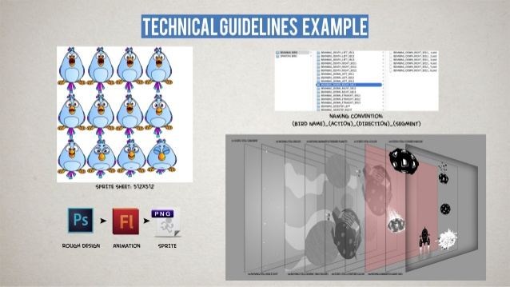
Technical Guidelines

Slide 20
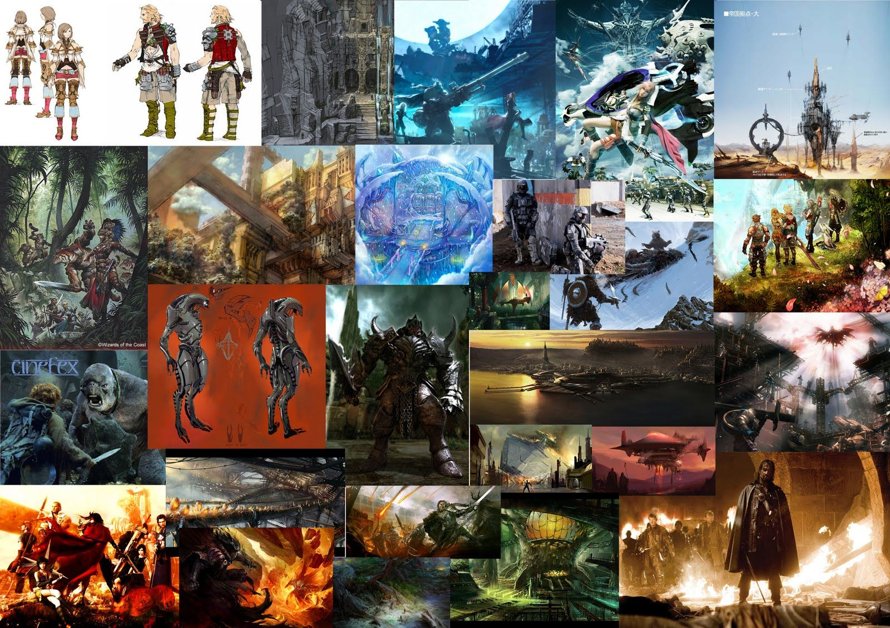
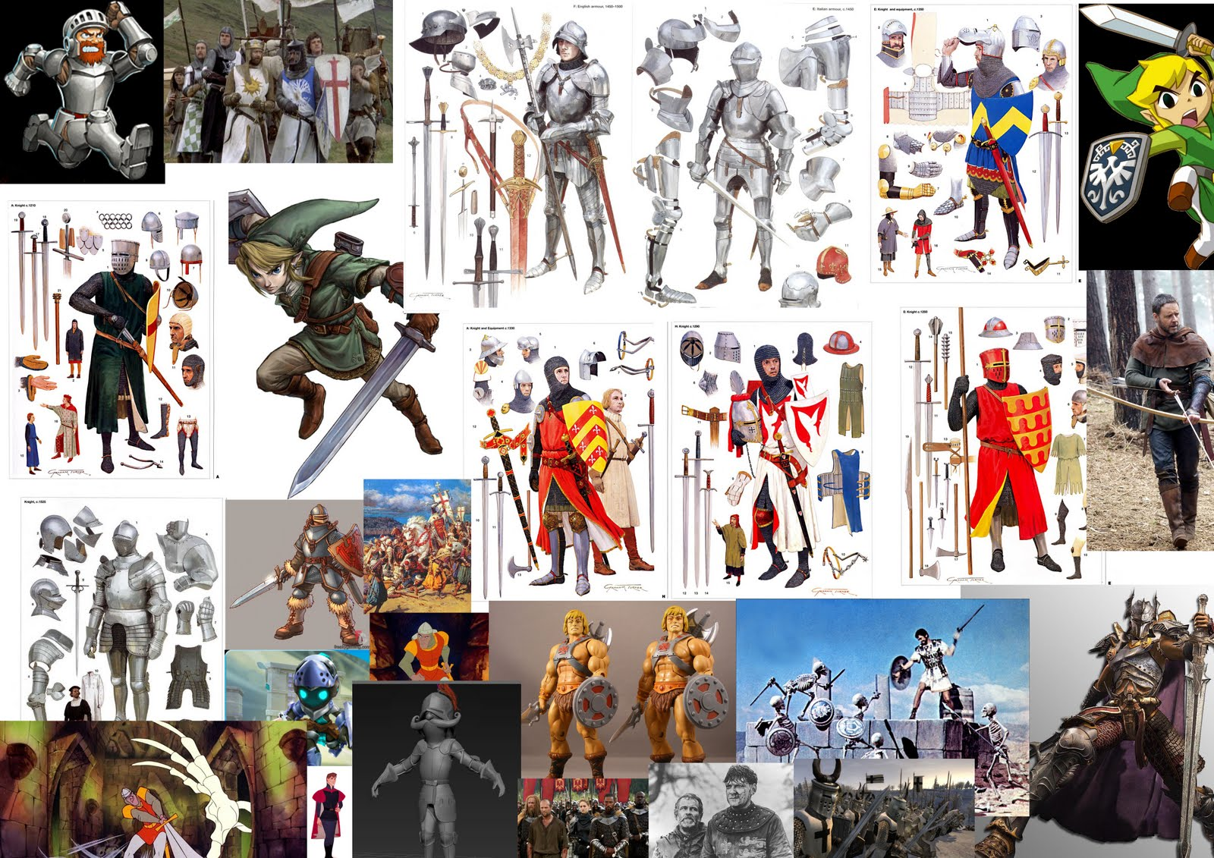
References

Slide 21
Questions?

Slide 22
Thanks For Your Attention

